Slide 1
Backtracking-part2
max clique and Travelling salesperson

Slide 2
Max clique
A subset U of the vertices of an undirected graph G defines a complete subgraph iff for every u and v in U, (u,v) is an edge of G.
The size of a subgraph is the number of vertices in it.
A complete subgraph is a clique of G iff it is not contained in a larger complete subgraph of G.
A max clique is a clique of maximum size

Slide 3
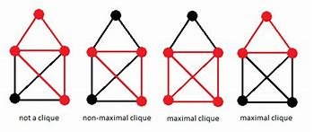

Slide 4
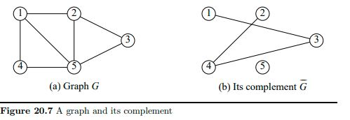
For any graph G, its complement G is a graph that has the same vertex set. further, (u,v) is an edge of G iff (u,v) is not an edge of G.
A subset U of vertices of G defines an empty subgraph iff for every u and v in U, (u,v) is not an edge of G.
The subset is an independent set of G iff the subset is not contained in a larger subset of vertices that also defines an empty subgraph
A max-independent set is an independent set of maximum size.

Slide 5
{2,4} defines an empty subgraph in Figure 20.7(a) and is also a max-independent set of this graph.
What about {1,2} in fig 20.7(b)??

Slide 6
Notice that if U defines a complete subgraph of G, then U also defines an empty subgraph of G’, and vice versa. So there is a correspondence between the cliques of G and the independent sets of G’. In particular, a max clique of G defines a max-independent set of G’
if we have an algorithm that solves the max-clique problem, we can solve the max-independent-set problem by first computing the complement of the given graph and then finding a max clique in the complement graph.

Slide 7
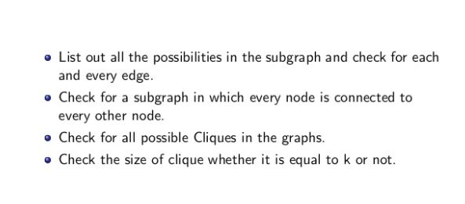
Approach k- max clique

Slide 8
Are we going to try all possible subsets in increasing size??
No.
Bounding function: when exploring the right branch, we need to verify that enough vertices remain so that there is a possibility of finding a larger clique in the right subtree.
Size of current clique+ N - currentlevel> Bestcliquesize?
Yes: the explore right tree

Slide 9
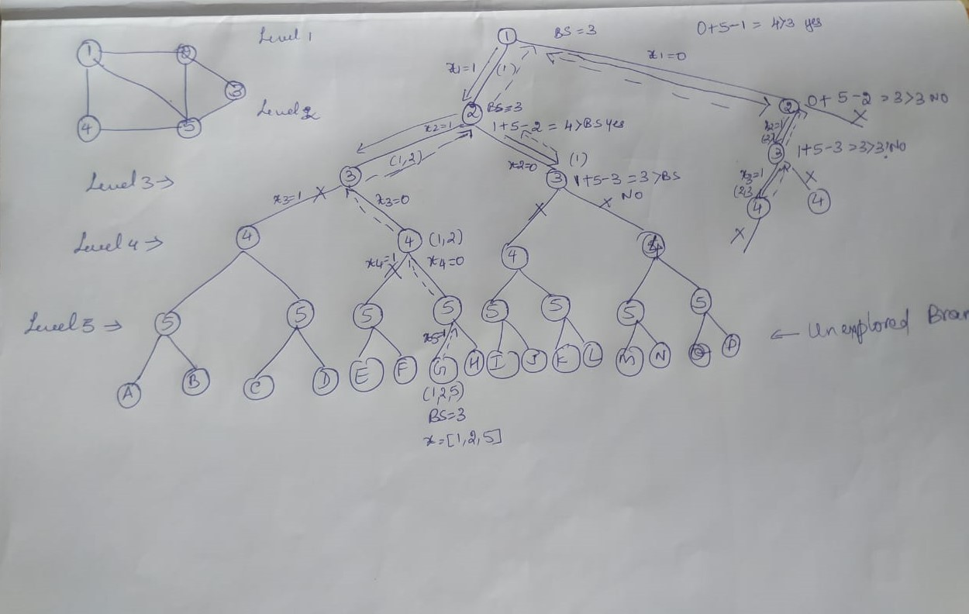

Slide 10
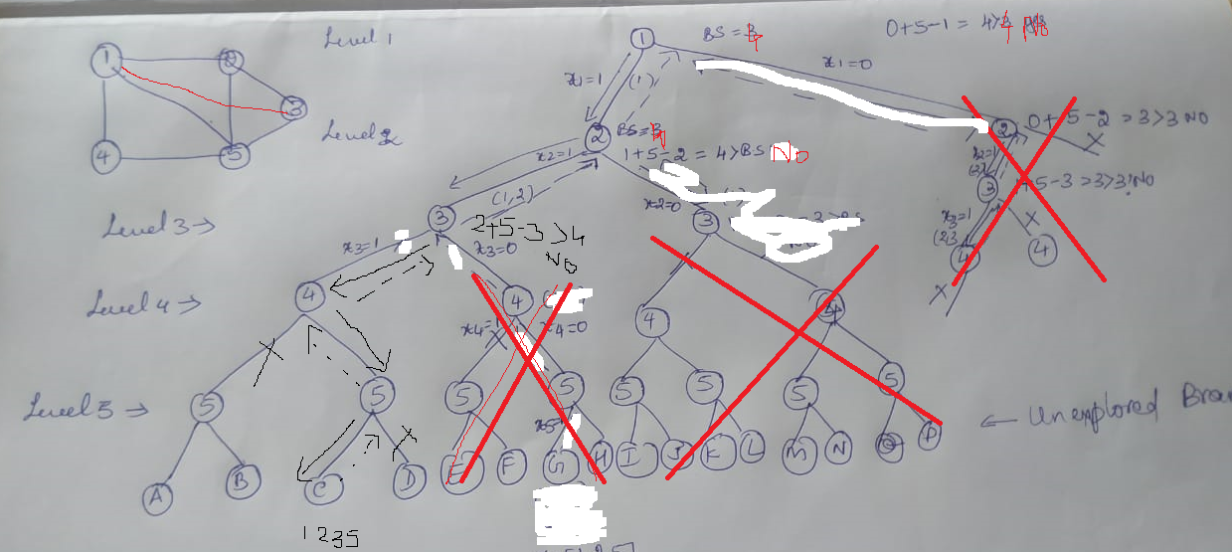

Slide 11
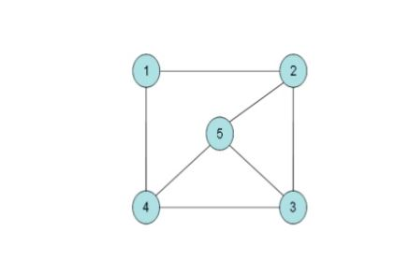
Solution space

Slide 12
complexity
The max-clique and max-independent-set problems may be solved by O(n2 ^{n}) time backtracking algorithms.

Slide 13
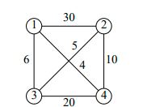
Traveling Salesperson
In this problem we are given an n vertex network (either directed or undirected) and are to find a cycle of minimum cost that includes all n vertices. Any cycle that includes all n vertices of a network is called a tour.
The vertices represent the cities (including the home base) in the salesperson’s territory. The edge costs give the travel time (or cost) required to go between two cities. A tour represents the path taken by the salesperson when visiting all cities in his/her territory and then returning home.

Slide 14
In the traveling-salesperson problem, we are to find a least-cost tour
The cost of the tour 1,2,4,3,1 is 66; that of 1,3,2,4,1 is 25;
and that of 1,4,3,2,1 is 59.
1,3,2,4,1 is the least-cost tour in the network.

Slide 15
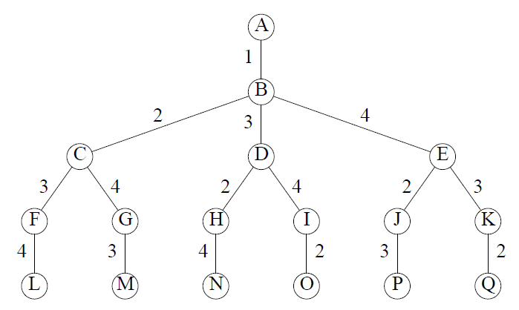
Solution space

Slide 16
Bounding function: If the cost of the partial tour built so far isn’t less than that of the best tour found to this point, kill the current node

Slide 17
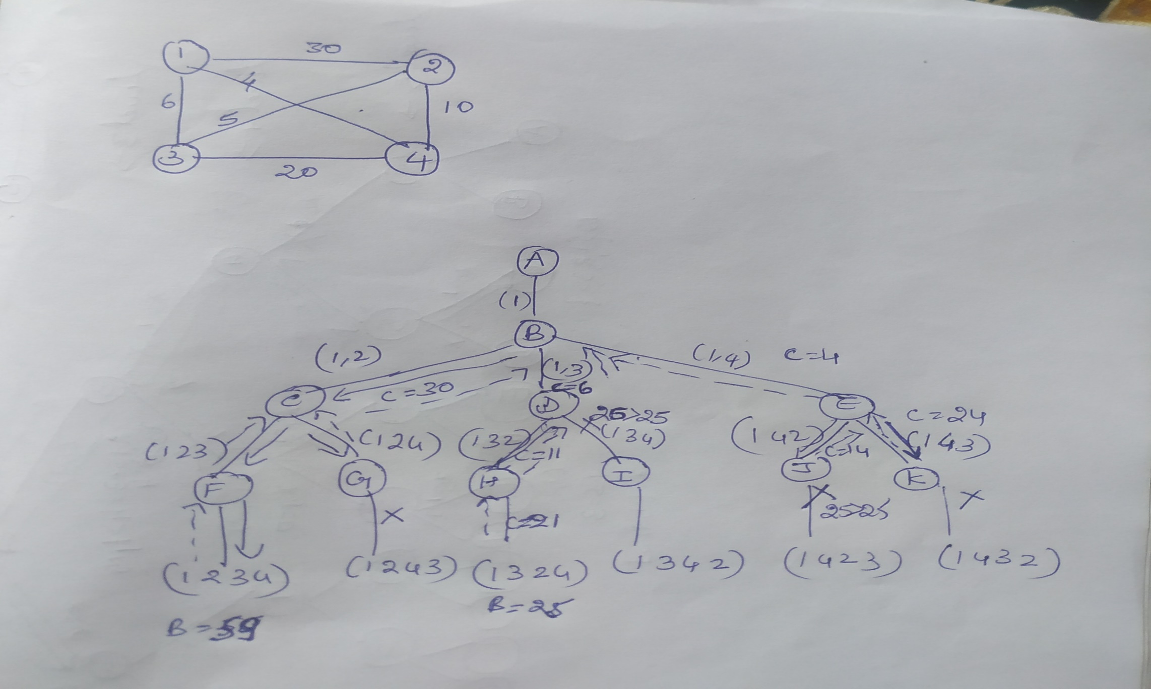

Slide 18
Time complexity
Excluding the cost of updating bestTourSoFar whenever a better tour is found, algorithm takes O((n − 1)!) time.
The updating time is O(n ∗ (n − 1)!), as O((n − 1)!) updates take place and each costs Θ(n) time. So the overall complexity is O(n!).

